Slide 1

CS362: COMPUTER NETWORKS
UNIT I: INTRODUCTION TO COMPUTER NETWORKS
Protocols layers and their service model

Slide 2
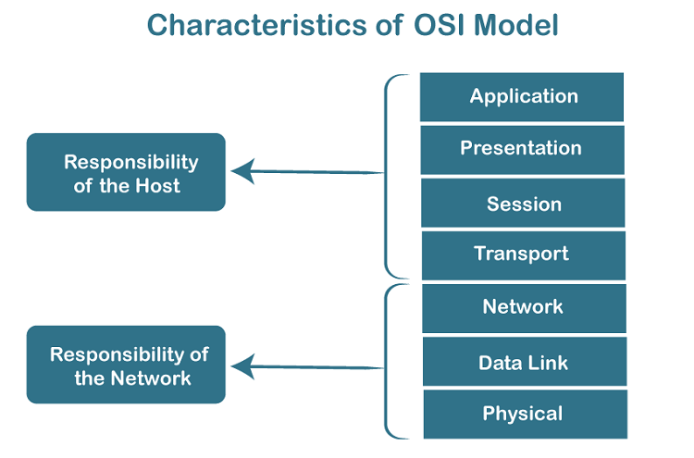
Protocols layers and their service model
OSI Layer Architecture
OSI model is based on a proposal developed by the International Standards Organization (ISO) as the first step toward international standardization of the protocols used in the various layers.
It was revised in 1995.
The model is called the OSI (Open Systems Interconnection) Reference Model because it deals with connecting open systems—that is, systems that are open for communication with other systems.
The OSI model has seven layers.

Slide 3
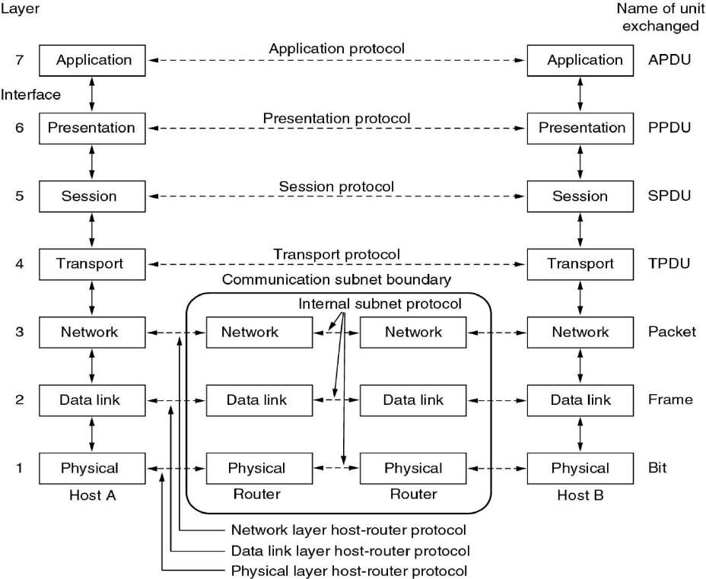

Slide 4
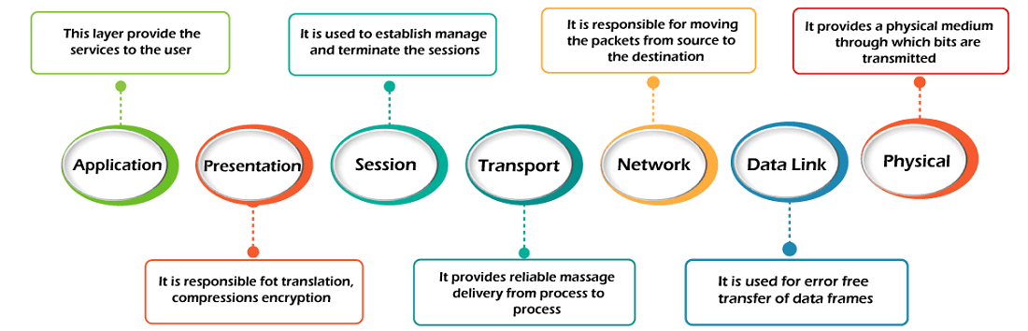

Slide 5
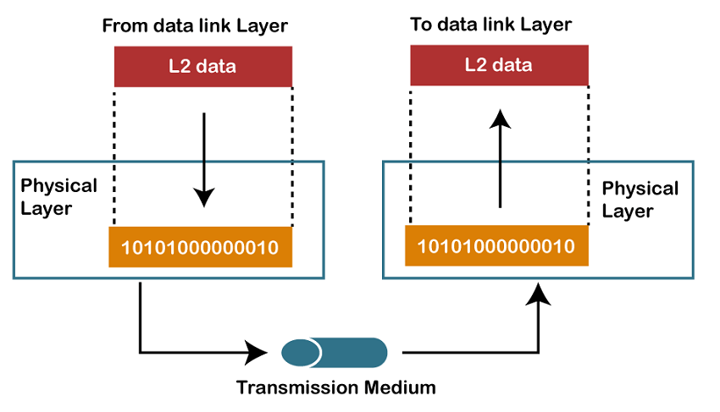
1. Physical layer
The main functionality of the physical layer is to
transmit the individual bits from one node to another
node.
It is the lowest layer of the OSI model.
It establishes, maintains and deactivates the physical connection.
It specifies the mechanical, electrical and procedural network interface specifications.
Functions of a Physical layer:
Line Configuration: It defines the way how two or more devices can be connected physically.
Data Transmission: It defines the transmission mode whether it is simplex, half-duplex or full-duplex mode between the two devices on the network.
Topology: It defines the way how network devices are arranged.
Signals: It determines the type of the signal used for transmitting the information.

Slide 6
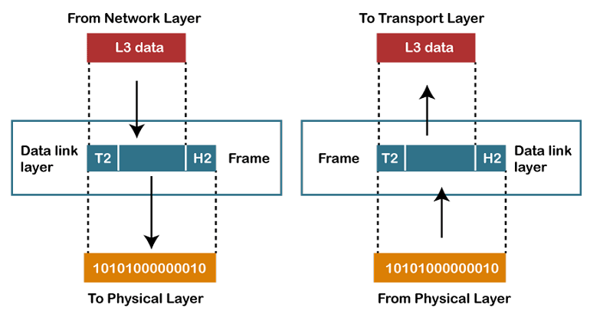
2. Data-Link Layer
responsible for the error-free transfer of data frames.
It defines the format of the data on the network.
It provides a reliable and efficient communication
between two or more devices.
It is mainly responsible for the unique identification of
each device that resides on a local network.
It contains two sub-layers:
Logical Link Control Layer
It is responsible for transferring the packets to the Network layer of the receiver that is receiving.
It identifies the address of the network layer protocol from the header.
It also provides flow control.
Media Access Control Layer
A Media access control layer is a link between the Logical Link Control layer and the network's physical layer.
It is used for transferring the packets over the network.

Slide 7
Functions of Data-Link Layer
Framing: The data link layer translates the physical's raw bit stream into packets known as Frames. The Data link layer adds the header and trailer to the frame. The header which is added to the frame contains the hardware destination and source address.
Physical Addressing: The Data link layer adds a header to the frame that contains a destination address. The frame is transmitted to the destination address mentioned in the header.
Flow Control: Flow control is the main functionality of the Data-link layer. It is the technique through which the constant data rate is maintained on both the sides so that no data get corrupted. It ensures that the transmitting station such as a server with higher processing speed does not exceed the receiving station, with lower processing speed.
Error Control: Error control is achieved by adding a calculated value CRC (Cyclic Redundancy Check) that is placed to the Data link layer's trailer which is added to the message frame before it is sent to the physical layer. If any error seems to occurr, then the receiver sends the acknowledgment for the retransmission of the corrupted frames.
Access Control: When two or more devices are connected to the same communication channel, then the data link layer protocols are used to determine which device has control over the link at a given time.

Slide 8
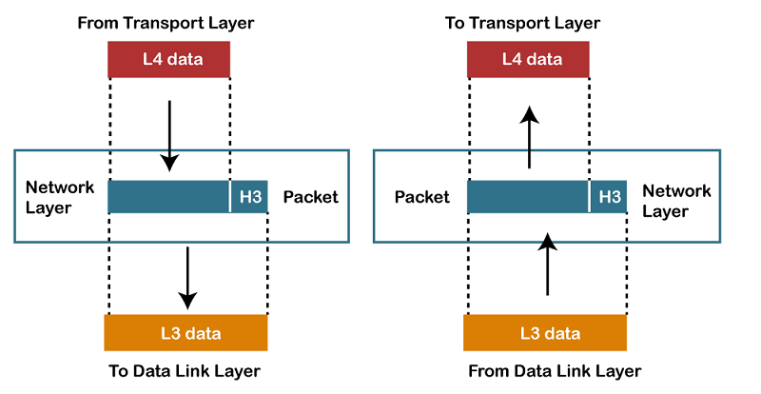
3. Network Layer
It is a layer 3 that manages device addressing, tracks the location of devices on the network.
It determines the best path to move data from source to the destination based on the network conditions, the priority of service, and other factors.
The Data link layer is responsible for routing and forwarding the packets.
Routers are the layer 3 devices, they are specified in this layer and used to provide the routing services within an internetwork.
The protocols used to route the network traffic are known as Network layer protocols. Examples of protocols are IPv4 and Ipv6.

Slide 9
3. Network Layer
Functions of Network Layer:
Internetworking: An internetworking is the main responsibility of the network layer. It provides a logical connection between different devices.
Addressing: A Network layer adds the source and destination address to the header of the frame. Addressing is used to identify the device on the internet.
Routing: Routing is the major component of the network layer, and it determines the best optimal path out of the multiple paths from source to the destination.
Packetizing: A Network Layer receives the packets from the upper layer and converts them into packets. This process is known as Packetizing. It is achieved by internet protocol (IP).

Slide 10
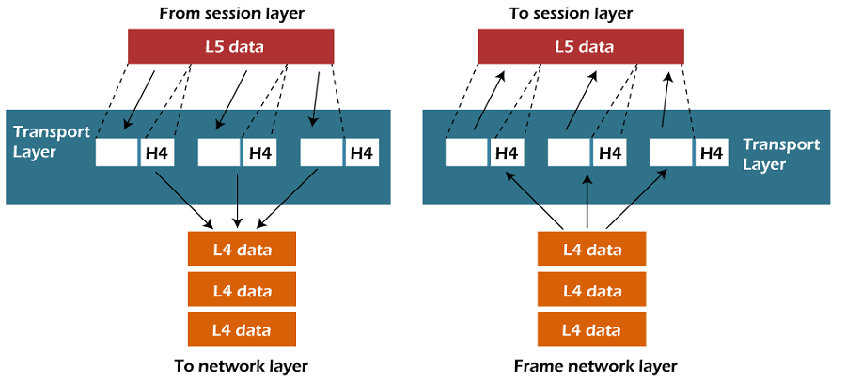
4. Transport Layer
The Transport layer is a Layer 4 ensures that messages are transmitted in the order in which they are sent and there is no duplication of data.
The main responsibility of the transport layer is to transfer the data completely.
It receives the data from the upper layer and converts them into smaller units known as segments.
This layer can be termed as an end-to-end layer as it provides a point-to-point connection between source and destination to deliver the data reliably.

Slide 11
4. Transport Layer
The two protocols used in this layer are:
Transmission Control Protocol
It is a standard protocol that allows the systems to communicate over the internet.
It establishes and maintains a connection between hosts.
When data is sent over the TCP connection, then the TCP protocol divides the data into smaller units known as segments. Each segment travels over the internet using multiple routes, and they arrive in different orders at the destination. The transmission control protocol reorders the packets in the correct order at the receiving end.
User Datagram Protocol
User Datagram Protocol is a transport layer protocol.
It is an unreliable transport protocol as in this case receiver does not send any acknowledgment when the packet is received, the sender does not wait for any acknowledgment. Therefore, this makes a protocol unreliable.

Slide 12
4. Transport Layer
Functions of Transport Layer:
Service-point addressing: Computers run several programs simultaneously due to this reason, the transmission of data from source to the destination not only from one computer to another computer but also from one process to another process. The transport layer adds the header that contains the address known as a service-point address or port address. The responsibility of the network layer is to transmit the data from one computer to another computer and the responsibility of the transport layer is to transmit the message to the correct process.
Segmentation and reassembly: When the transport layer receives the message from the upper layer, it divides the message into multiple segments, and each segment is assigned with a sequence number that uniquely identifies each segment. When the message has arrived at the destination, then the transport layer reassembles the message based on their sequence numbers.
Connection control: Transport layer provides two services Connection-oriented service and connectionless service. A connectionless service treats each segment as an individual packet, and they all travel in different routes to reach the destination. A connection-oriented service makes a connection with the transport layer at the destination machine before delivering the packets. In connection-oriented service, all the packets travel in the single route.
Flow control: The transport layer also responsible for flow control but it is performed end-to-end rather than across a single link.
Error control: The transport layer is also responsible for Error control. Error control is performed end-to-end rather than across the single link. The sender transport layer ensures that message reach at the destination without any error.

Slide 13
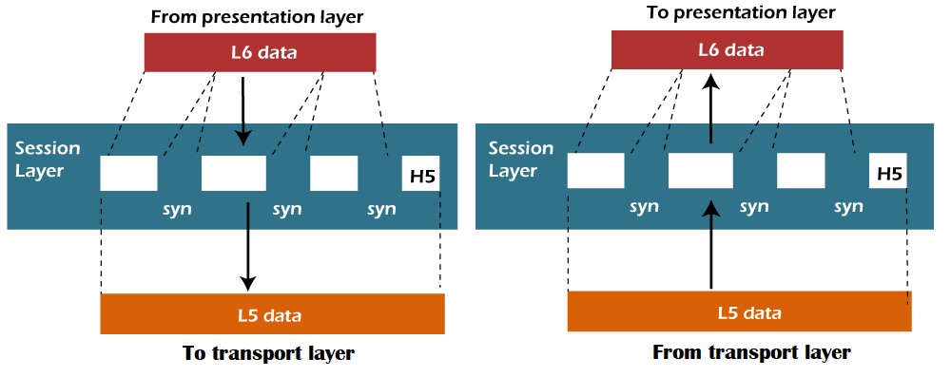
5. Session Layer
It is a layer 3 from top in the OSI model.
The Session layer is used to establish, maintain and synchronizes the interaction between communicating devices.

Slide 14
5. Session Layer
Functions of Session layer:
Dialog control: Session layer acts as a dialog controller that creates a dialog between two processes or we can say that it allows the communication between two processes which can be either half-duplex or full-duplex.
Synchronization: Session layer adds some checkpoints when transmitting the data in a sequence. If some error occurs in the middle of the transmission of data, then the transmission will take place again from the checkpoint. This process is known as Synchronization and recovery.

Slide 15
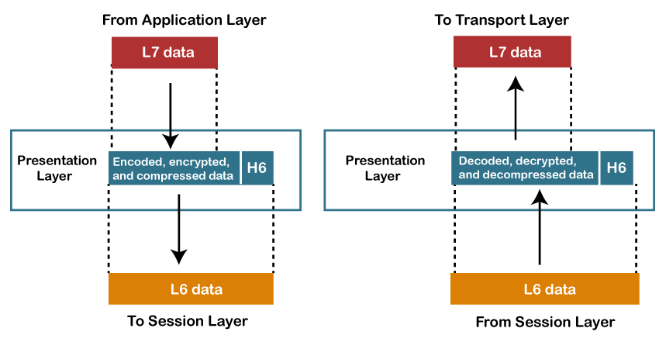
6. Presentation Layer
A Presentation layer is mainly concerned with the syntax and semantics of the information exchanged between the two systems.
It acts as a data translator for a network.
This layer is a part of the operating system that converts the data from one presentation format to another format.
The Presentation layer is also known as the syntax layer.

Slide 16
6. Presentation Layer
Functions of Presentation layer:
Translation: The processes in two systems exchange the information in the form of character strings, numbers and so on. Different computers use different encoding methods, the presentation layer handles the interoperability between the different encoding methods. It converts the data from sender-dependent format into a common format and changes the common format into receiver-dependent format at the receiving end.
Encryption: Encryption is needed to maintain privacy. Encryption is a process of converting the sender-transmitted information into another form and sends the resulting message over the network.
Compression: Data compression is a process of compressing the data, i.e., it reduces the number of bits to be transmitted. Data compression is very important in multimedia such as text, audio, video.

Slide 17
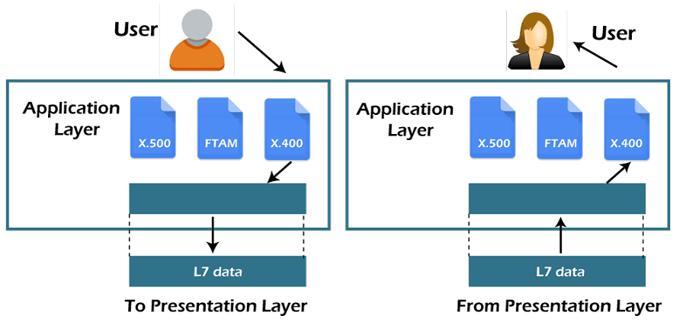
7. Application Layer
An application layer serves as a window for users and application processes to access network service.
It handles issues such as network transparency, resource allocation, etc.
An application layer is not an application, but it performs the application layer functions.
This layer provides the network services to the end-users.

Slide 18
7. Application Layer
Functions of Application layer:
File transfer, access, and management (FTAM): An application layer allows a user to access the files in a remote computer, to retrieve the files from a computer and to manage the files in a remote computer.
Mail services: An application layer provides the facility for email forwarding and storage.
Directory services: An application provides the distributed database sources and is used to provide that global information about various objects.

Slide 19
TCP/IP Model
The OSI Model : designed to describe the functions of the communication system by dividing the communication procedure into smaller and simpler components.
TCP/IP was designed and developed by the Department of Defense (DoD) in the 1960s and is based on standard protocols. It stands for Transmission Control Protocol/Internet Protocol. It is concise version of the OSI model. It contains four layers, unlike the seven layers in the OSI model.

Slide 20
What Does TCP/IP Do?
transfer the data of a computer from one device to another
to make data reliable and accurate
ensure that, each message reaches its final destination accurately
divides its data into packets and combines them at the other end
Difference between TCP and IP
IP finds the destination of the mail and TCP has the work to send and receive the mail

Slide 21
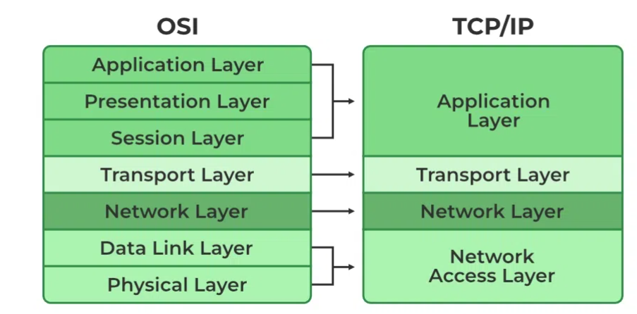
Layers of TCP/IP Model

Slide 22
Layers of TCP/IP Model
1. Physical Layer:
group of applications requiring network communications
responsible for generating the data and requesting connections
acts on behalf of the sender and the Network Access layer on the behalf of the receiver
2. Data Link Layer
The packet’s network protocol type, in this case, TCP/IP, is identified by the data-link layer.
Error prevention and “framing” are also provided by the data-link layer.
Point-to-Point Protocol (PPP) framing and Ethernet IEEE 802.2 framing are two examples of data-link layer protocols.

Slide 23
Layers of TCP/IP Model
3. Internet Layer: Defines the protocols which are responsible for the logical transmission of data over the entire network.
The main protocols residing at this layer are as follows:
IP: Internet Protocol: responsible for delivering packets from the source host to the destination host by looking at the IP addresses in the packet headers. IP has 2 versions: IPv4 and IPv6.
ICMP: Internet Control Message Protocol: encapsulated within IP datagrams and is responsible for providing hosts with information about network problems.
ARP: Address Resolution Protocol : Its job is to find the hardware address of a host from a known IP address. ARP has several types: Reverse ARP, Proxy ARP, Gratuitous ARP, and Inverse ARP.

Slide 24
Layers of TCP/IP Model
4. Transport Layer: transport layer protocols exchange data receipt acknowledgments and retransmit missing packets to ensure that packets arrive in order and without error. End-to-end communication is referred to as such. Transmission Control Protocol (TCP) and User Datagram Protocol are transport layer protocols at this level (UDP).
TCP: Applications can interact with one another using TCP as though they were physically connected by a circuit. TCP transmits data in a way that resembles character-by-character transmission rather than separate packets
UDP: The datagram delivery service is provided by UDP, the other transport layer protocol. Connections between receiving and sending hosts are not verified by UDP

Slide 25
Layers of TCP/IP Model
5. Application Layer: responsible for end-to-end communication and error-free delivery of data. It shields the upper-layer applications from the complexities of data.
The three main protocols present in this layer are:
HTTP and HTTPS: Hypertext transfer protocol: used by the World Wide Web to manage communications between web browsers and servers. HTTP-Secure: It is a combination of HTTP with SSL(Secure Socket Layer). It is efficient in cases where the browser needs to fill out forms, sign in, authenticate, and carry out bank transactions.
SSH: SSH stands for Secure Shell. It is a terminal emulations software similar to Telnet. The reason SSH is preferred is because of its ability to maintain the encrypted connection. It sets up a secure session over a TCP/IP connection.
NTP: Network Time Protocol: used to synchronize the clocks on our computer to one standard time source. It is very useful in situations like bank transactions. Assume the following situation without the presence of NTP. Suppose you carry out a transaction, where your computer reads the time at 2:30 PM while the server records it at 2:28 PM. The server can crash very badly if it’s out of sync. The host-to-host lay

